Slide 1

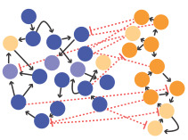

Part 1: Contingency and GRN architecture constraints in the evolution of network topology and novel patterns Part 2: An introduction to numerical computing with Julia Harry Booth 27/10/2022

Slide 2
What is contingency?
Chance events that shaped human history:
Extinction of the dinosaurs
Rejection of Hitler from art school
Meeting my wife
Contingency, philosopher John Beatty has written, essentially means that history matters “when a particular future depends on a particular past that was not bound to happen, but did.”
Question: To what extinct is natural evolution subject to contingent forces? Is it path dependent?
What if we could replay the “tape of life”?
“Replay the tape a million times...and I doubt that anything like Homo sapiens would ever evolve again.”
Stephen Jay Gould, Wonderful Life
Notes:
To what extent is evolution “path dependent”

Slide 3
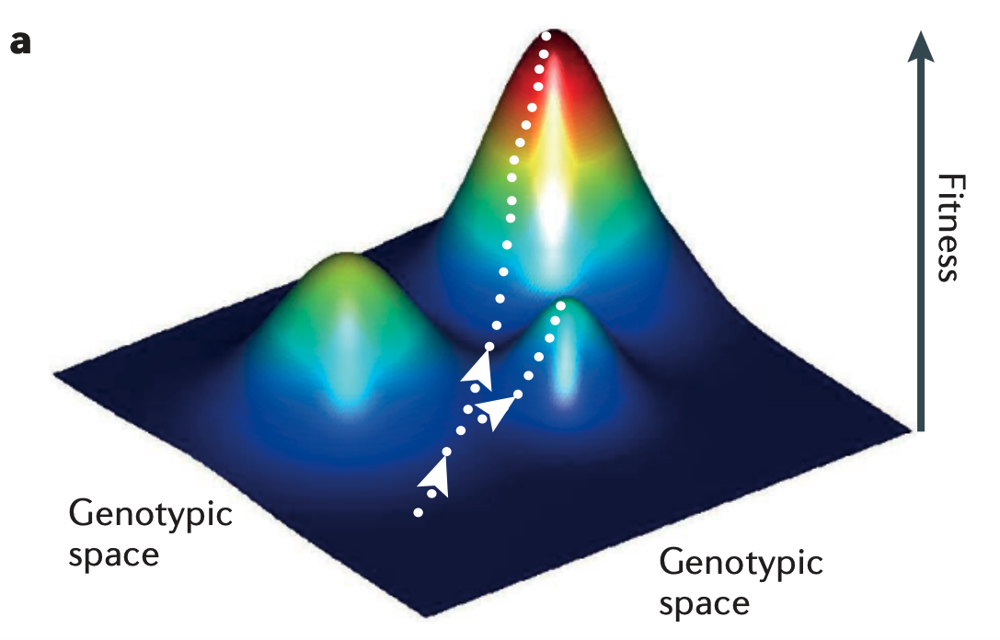
An adaptive landscape view
De Visser, J. A. G. M., & Krug, J. (2014).
For determinism:
Natural selection tends to push the population uphill to higher average fitness
For contingency:
Stochastic mutation yields differing trajectories - Mani, G. S., & Clarke, B. C. (1990)
Random initial condition in rugged landscapes- Lobkovsky, A. E., Wolf, Y. I., & Koonin, E. V. (2011)
Could contribute in either direction:
Fitness landscape (“the evolutionary routes are many, but the destinations are limited.”)
Accessibility of phenotypes through mutation - Jiménez, A., Cotterell, J., Munteanu, A., & Sharpe, J. (2015)
Developmental processes!
Notes:
Uphill climbing :
Stochastic mutation : magnitudes, order
Initial condition : degree to which the starting and ending points determine the path of evolution in fitness landscapes is shown to increase as the fitness landscape becomes more rugged (predictability of evo trajectories in fitness landscapes)
Fitness landscape constrained by development mechanisms
Accessibility: Mutational neighborhood

Slide 4
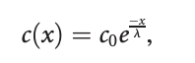
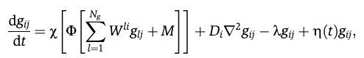
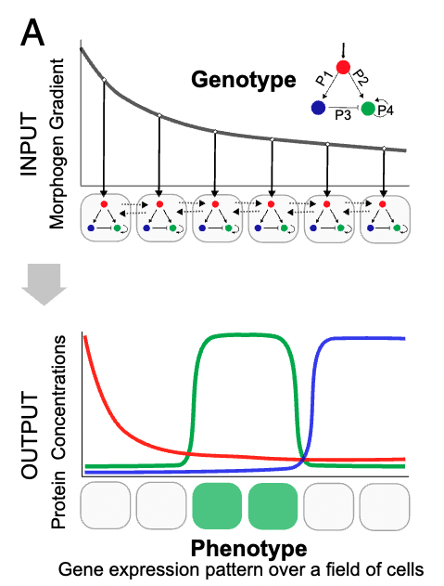
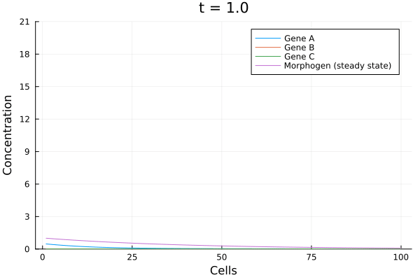
A developmental model of stripe formation in response to a morphogen gradient
Jiménez, A., Cotterell, J., Munteanu, A., & Sharpe, J. (2015)
Morphogen:
Notes:
Gould wrote,“The bad news is that we can’t possibly perform the experiment.”
L = 1,
Lambda_m = 0.4
c0 = 1.

Slide 5
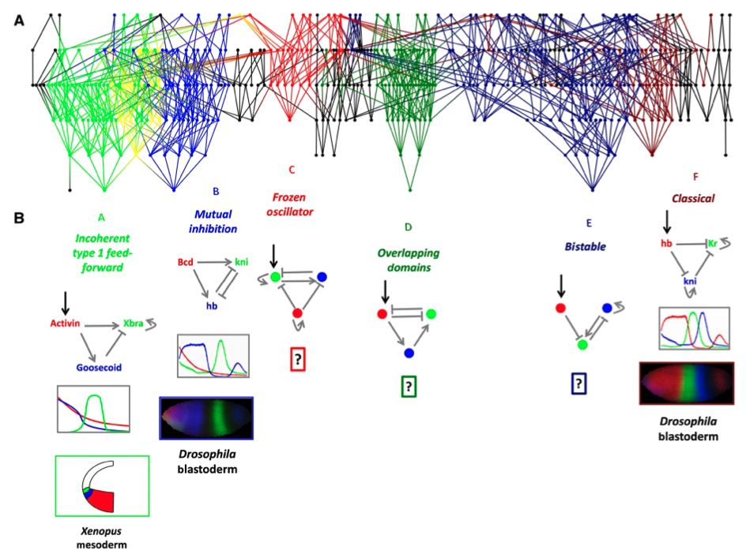
Many GRN topologies can produce stripe-like patterns
Jiménez, A., Cotterell, J., Munteanu, A., & Sharpe, J. (2015)
Cotterell, J., & Sharpe, J. (2010)
Notes:
enumerated every possible unique topology with the condition that one of the genes was activated by the morphogen. This resulted in 9710 topologies
tested 30000 randomly chosen parameter sets for each topology
From the 300 million genotypes tested, 3379 were able to produce a stripe in a noise-robust manner. These successful ‘solutions’ mapped to 471 GRN topologies of the fully enumerated set of 9710.
The complexity atlas reveals that a variety of distinct dynamical mechanisms can achieve the same function (stripe formation)
Therefore: why has evolution converged on some designs and not others? If it was re-run, would we come to the same networks? Does starting position matter?

Slide 6
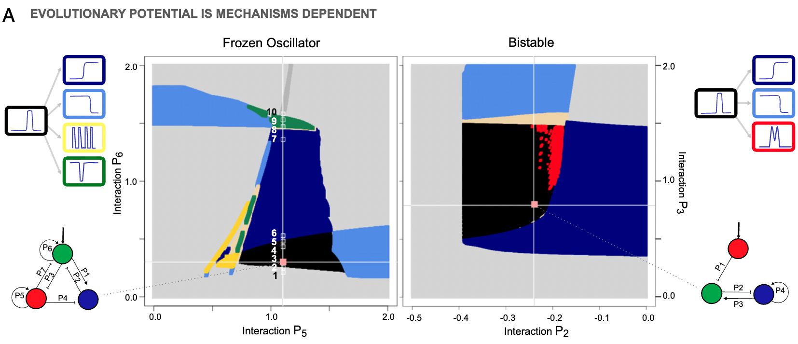
Evolutionary potential is mechanism dependent
Jiménez, A., Cotterell, J., Munteanu, A., & Sharpe, J. (2015)
Notes:
Multiple topologies can give rise to a specific phenotype
The phenotypes accessible through mutation are (in some way) topology dependent, which affects evolvability
Possible mutation paths restricted by current topology

Slide 7
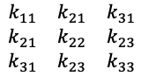
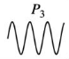
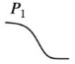
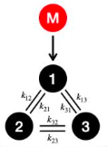
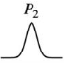

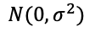

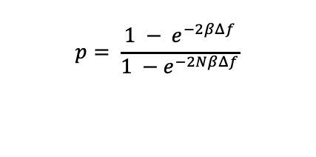
Modelling evolution in-silico
Real-encoded mutation
Fitness evaluation
$$\begin{matrix}k_{11} & k_{21} & k_{31} \\ k_{21} & k_{22} & k_{23} \\ k_{31} & k_{23} & k_{33}\end{matrix}$$
+
*
$$N(0,σ^{2})$$
vs
given
Target
New phenotype
Create mutant
Calculate fitness differential $Δf$
Modified genotype
Population with dominant individual
rand() < $p$
$$p= \frac{1 − e^{−2βΔf}}{1 −e^{−2NβΔf}}$$
Calculate invasion probability
else

Slide 8
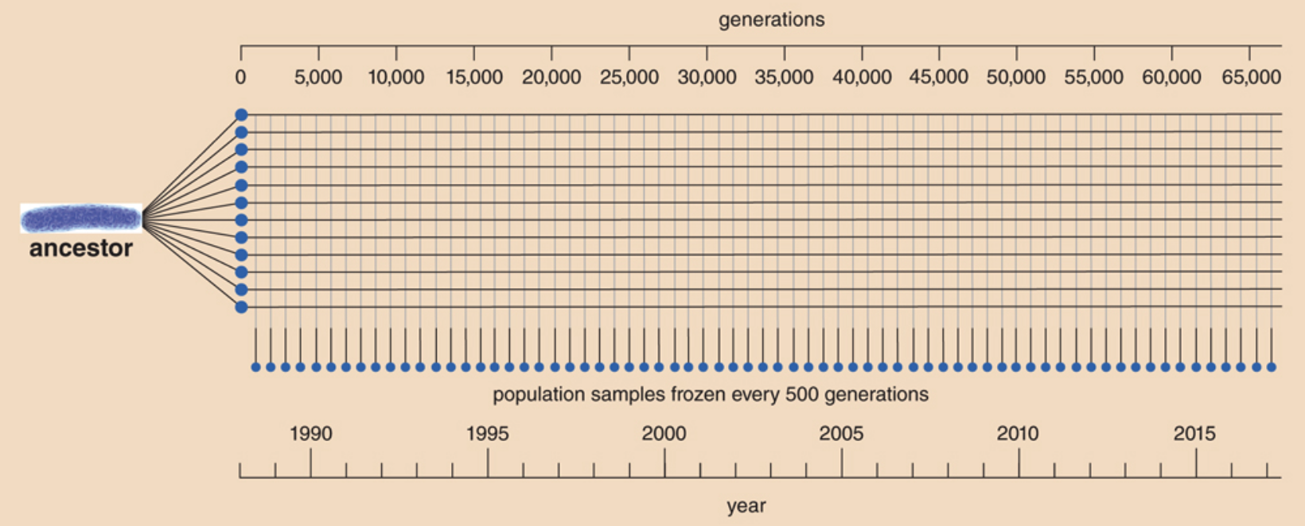
E. coli long-term evolution experiment – parallel replay
American Scientist: Replaying Evolution
Notes:
Richard Lenski began the LTEE in 1988. For more than 66,500 generations, the project has followed the evolution of 12 initially identical populations of E. coli.
Living samples of each population are frozen every 75 days, or about every 500 generations.
Thus, ancestral and evolved clones can be revived for direct comparison and studied with other organisms at different stages of the experiment.
The experiment is highly simplified: The environment never changes. Mutation is the sole source of the new variation that is grist for the mill of natural selection,
how repeatable is evolution under identical conditions?

Slide 9
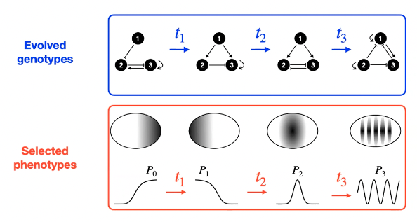
Replaying the tape of evolution - is evolution more subject to deterministic or contingent forces?
Architectural constraints:
Numerous topologies can produce the same start pattern. How contingent is the final topology on the start topology?
Role of stochasticity:
Genotype transitions (mutations) are stochastic. How contingent is the final topology on this randomness? (parallel replay)
Evolution: version n
Ecological constraints:
How contingent is the final topology on the temporal sequencing of ecological shifts?

Slide 10
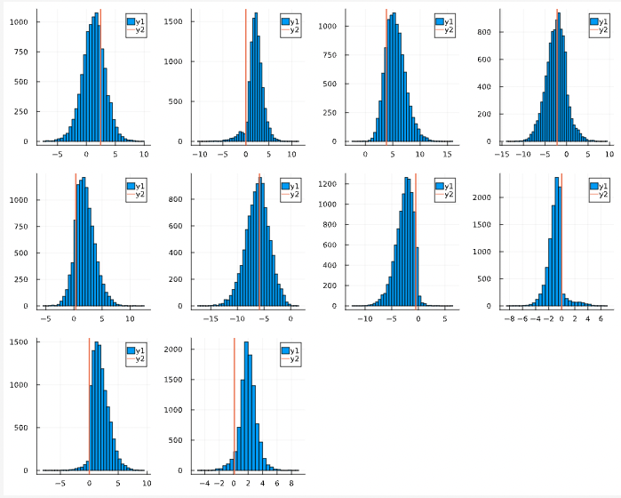
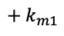
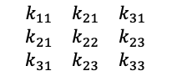
Initial experiments and preliminary results
Evolution: version n = 1:10,000
Parallel replay:
Evolution was ran 10,000 times, with the same initial topology and targeted pattern
Evolution ran for a maximum of 10,000 generations, or until fitness threshold reached
$$\begin{matrix}k_{11} & k_{21} & k_{31} \\ k_{21} & k_{22} & k_{23} \\ k_{31} & k_{23} & k_{33}\end{matrix}$$
$$+ k_{m1}$$

Slide 11
An Introduction to Julia

Slide 12
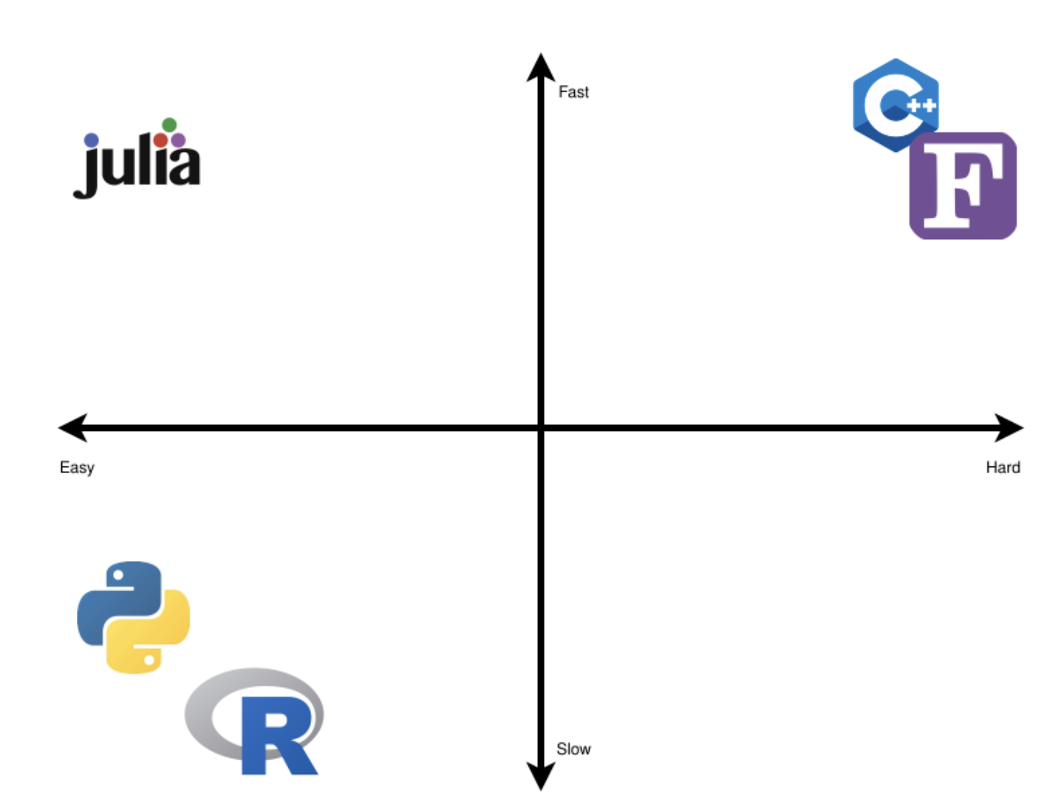
A solution to the “Two-Language Problem”…
Performance (ceiling)
Implementation
Language difficulty
Prototyping
… have your cake and eat it too!

Slide 13
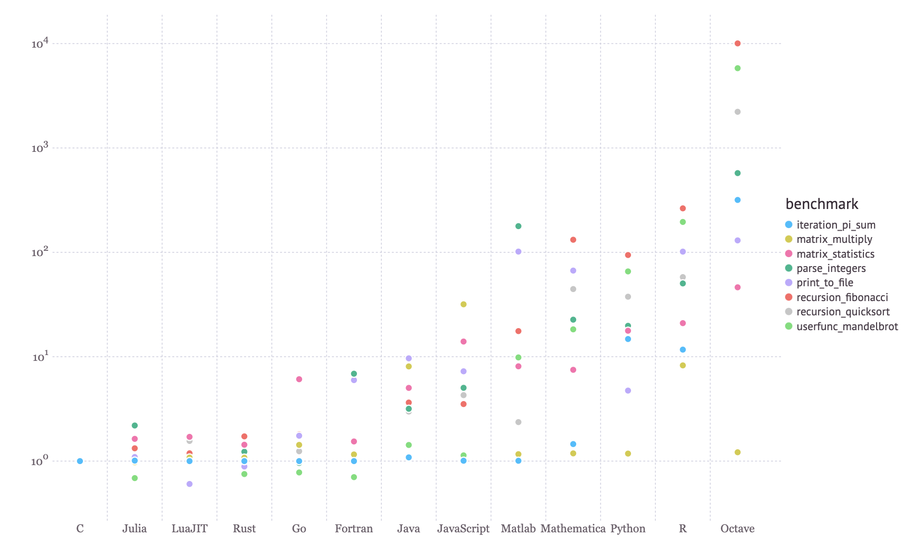
How fast?
https://julialang.org/benchmarks/

Slide 14
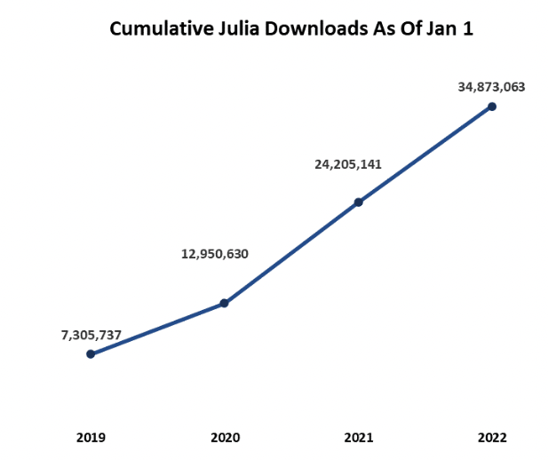
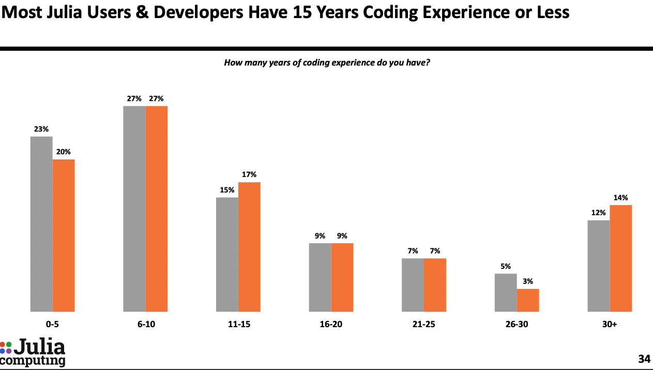
How easy?
2022 Julia User Survey
Newsletter January 2022 - Julia Growth Statistics/

Slide 15

Take a slow code, and make it better

Slide 16
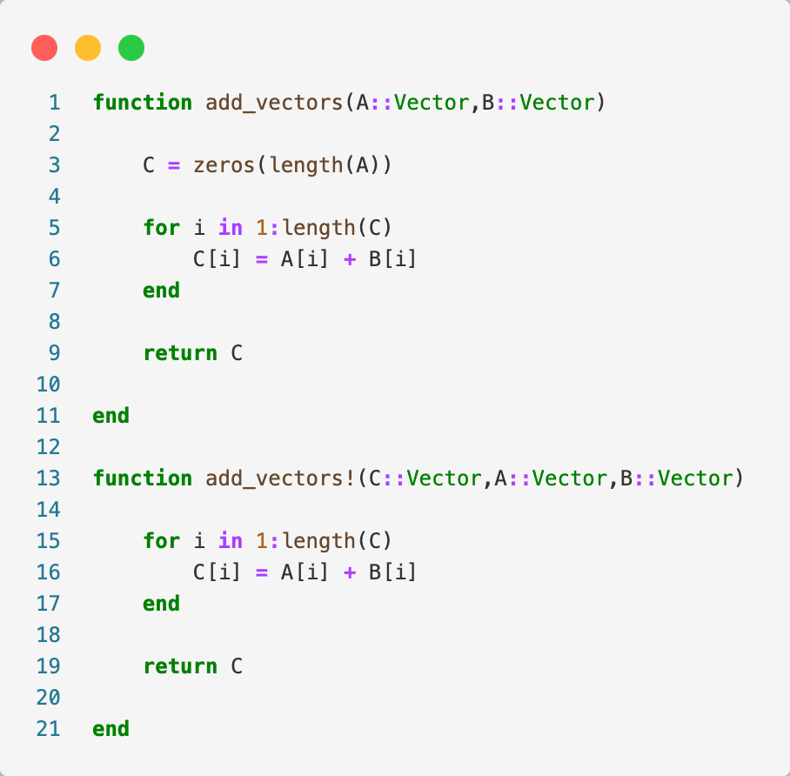
Basics, and two straight-forward performance tips – adding vectors

Slide 17
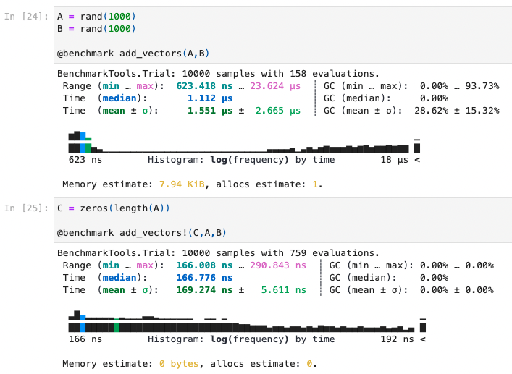
Basics, and two straight-forward performance tips – allocations
Performance tip 1: Reduce allocations / pre-allocate

Slide 18
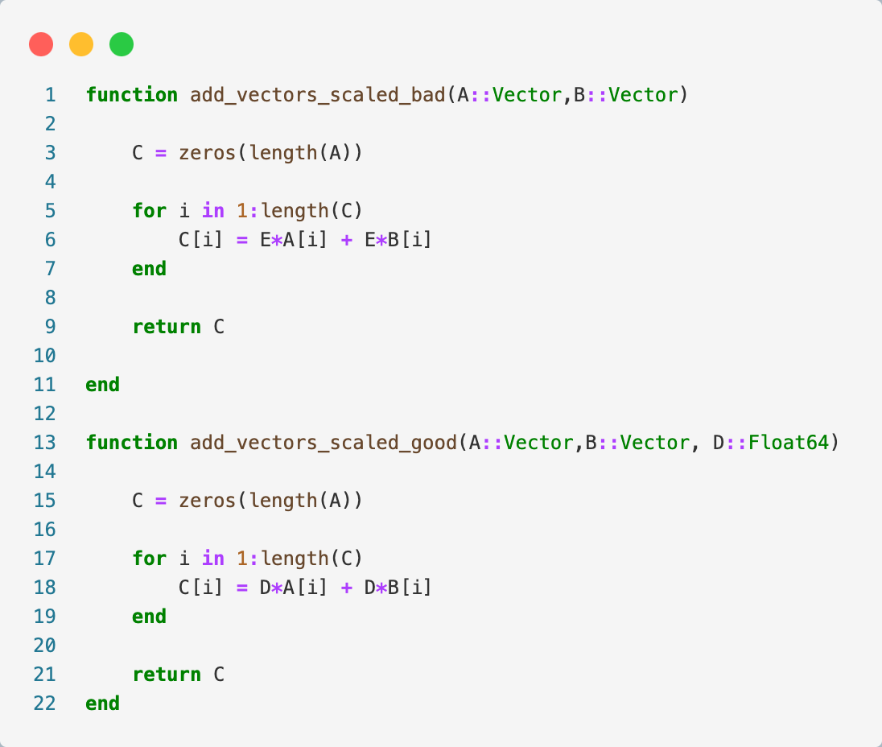
Basics, and two straight-forward performance tips – scaled vector addition

Slide 19
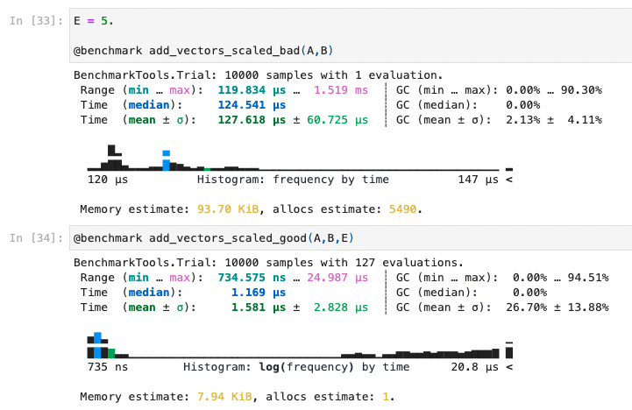
Basics, and two straight-forward performance tips
Performance tip 2: Be very careful with global variables

Slide 20
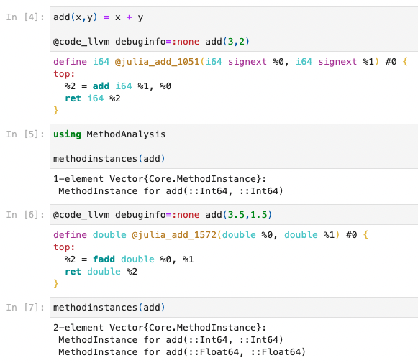
Key design feature #1 : automatic compilation of user code to LLVM (Low Level Virtual Machine)
This paradigm offers significant speedup over Python, at the cost of ‘warmup’ time

Slide 21
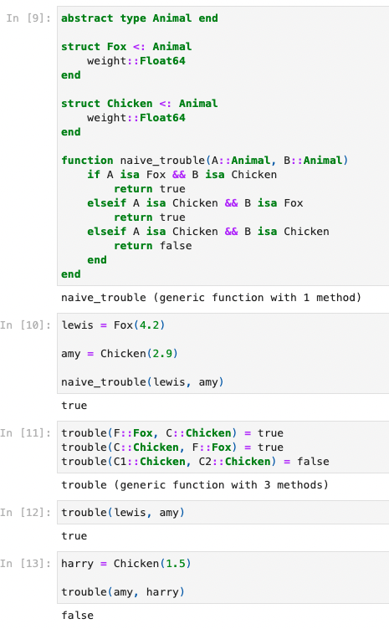
Key design feature #2 : multiple dispatch
Types : objects with certain characteristics, with ‘rules’ defined for their behaviours. Julia has a very powerful type system.
Multiple dispatch is a powerful feature that allows us to extend existing functions or to define custom and complex behaviour for new types.
Notes:
1. Composability

Slide 22
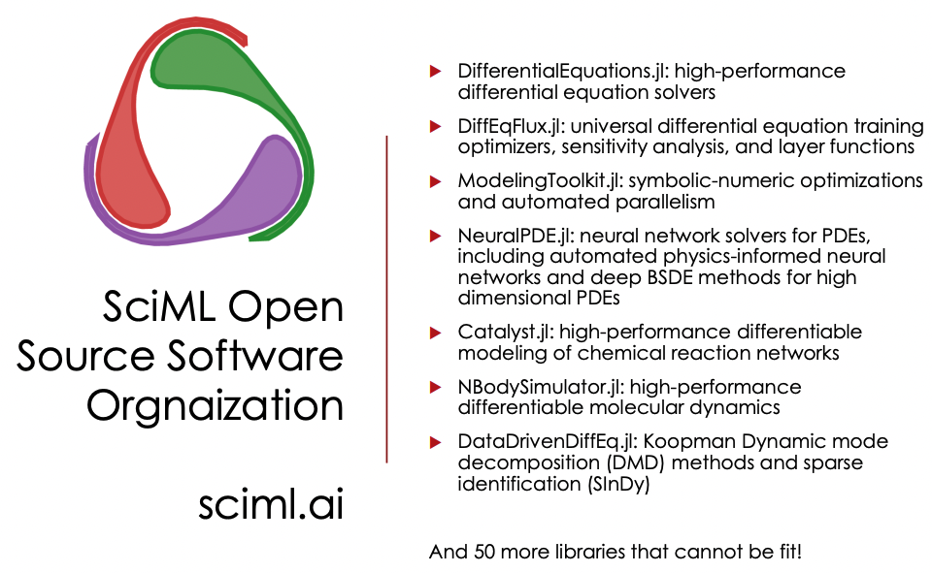
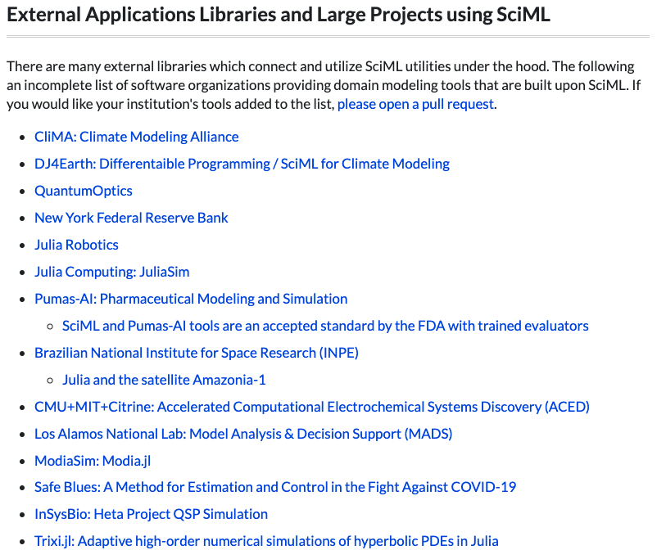
Solving Differential Equations in Julia using DifferentialEquations.jl

Slide 23
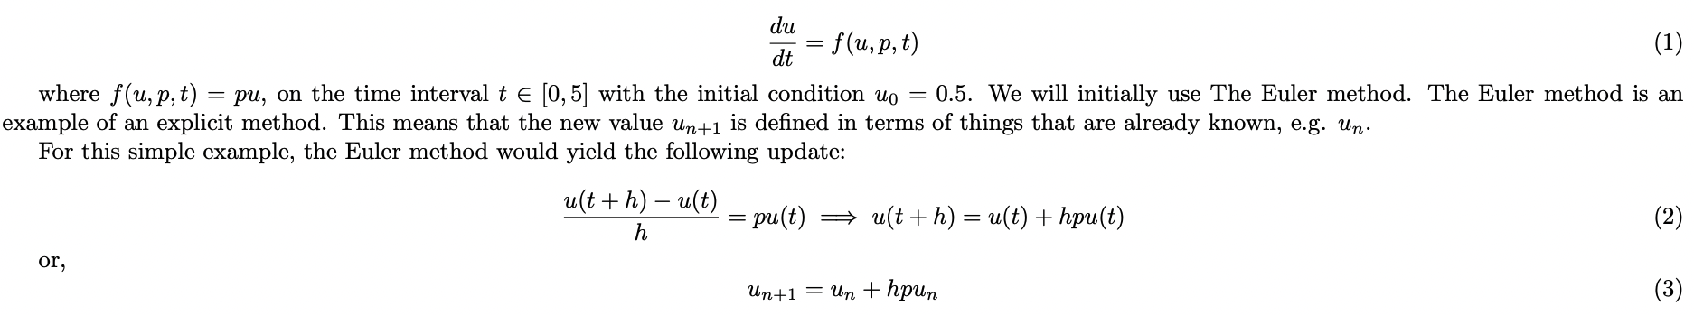
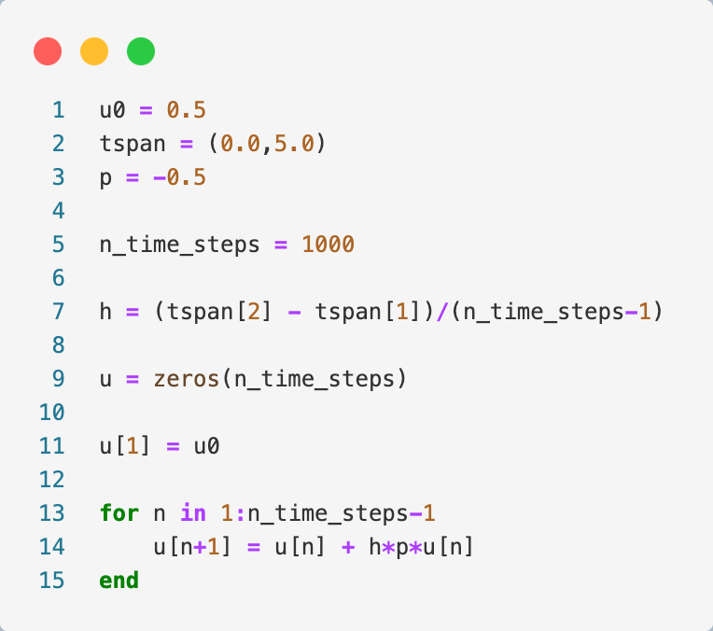
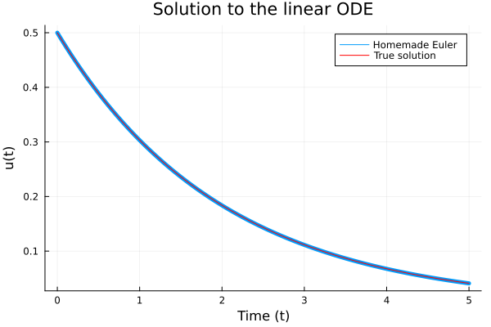
Solving a simple ODE – homemade approach

Slide 24
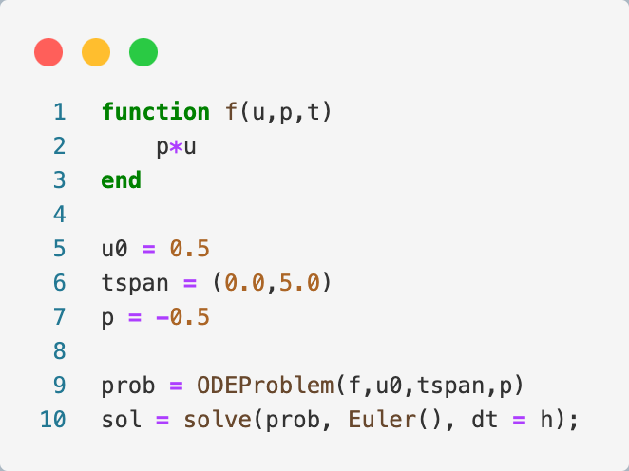
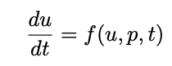
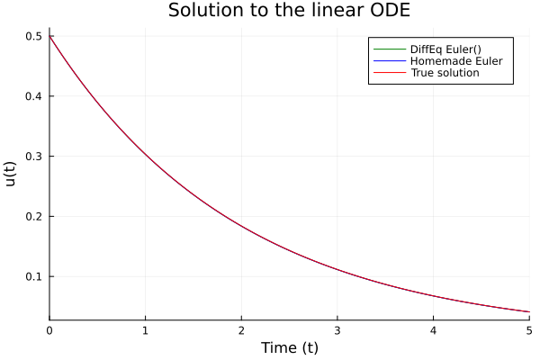
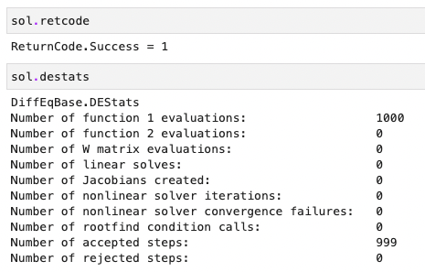
Solving a simple ODE with DifferentialEquations.jl – problem setup
Euler source code

Slide 25
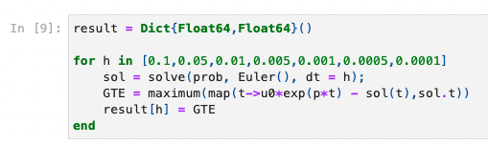
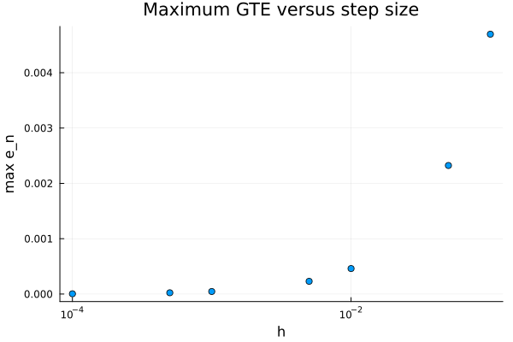
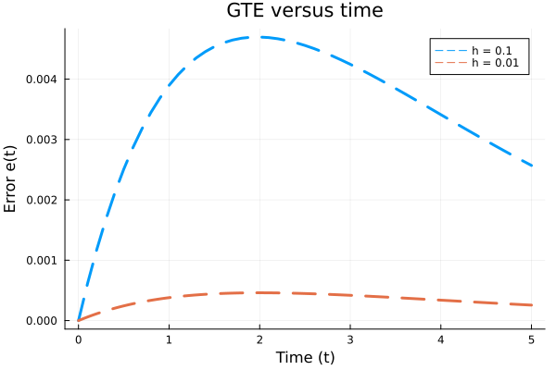
Solving a simple ODE with DifferentialEquations.jl – global truncation error (GTE)
Notes:
Note that error determined by dt. How to decide? Need error estimates

Slide 26
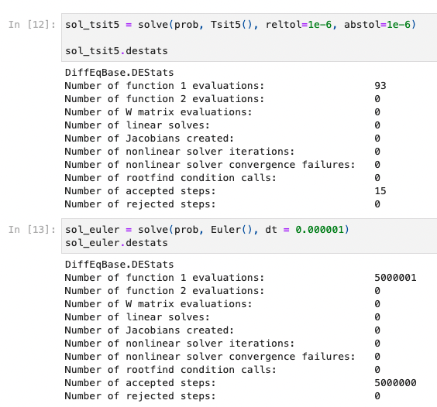
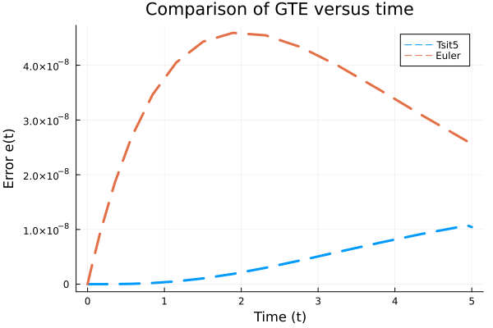
Solving a simple ODE with DifferentialEquations.jl – Tsit5(), a Runga-Kutta adaptive method

Slide 27
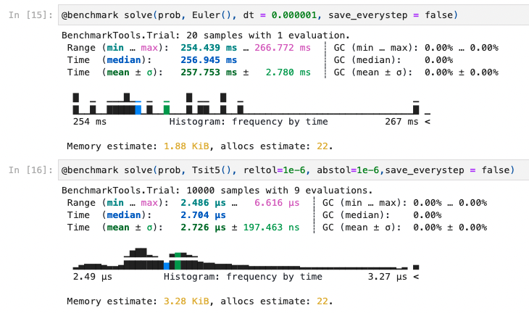
Solving a simple ODE– Benchmark Euler versus Tsit5()

Slide 28
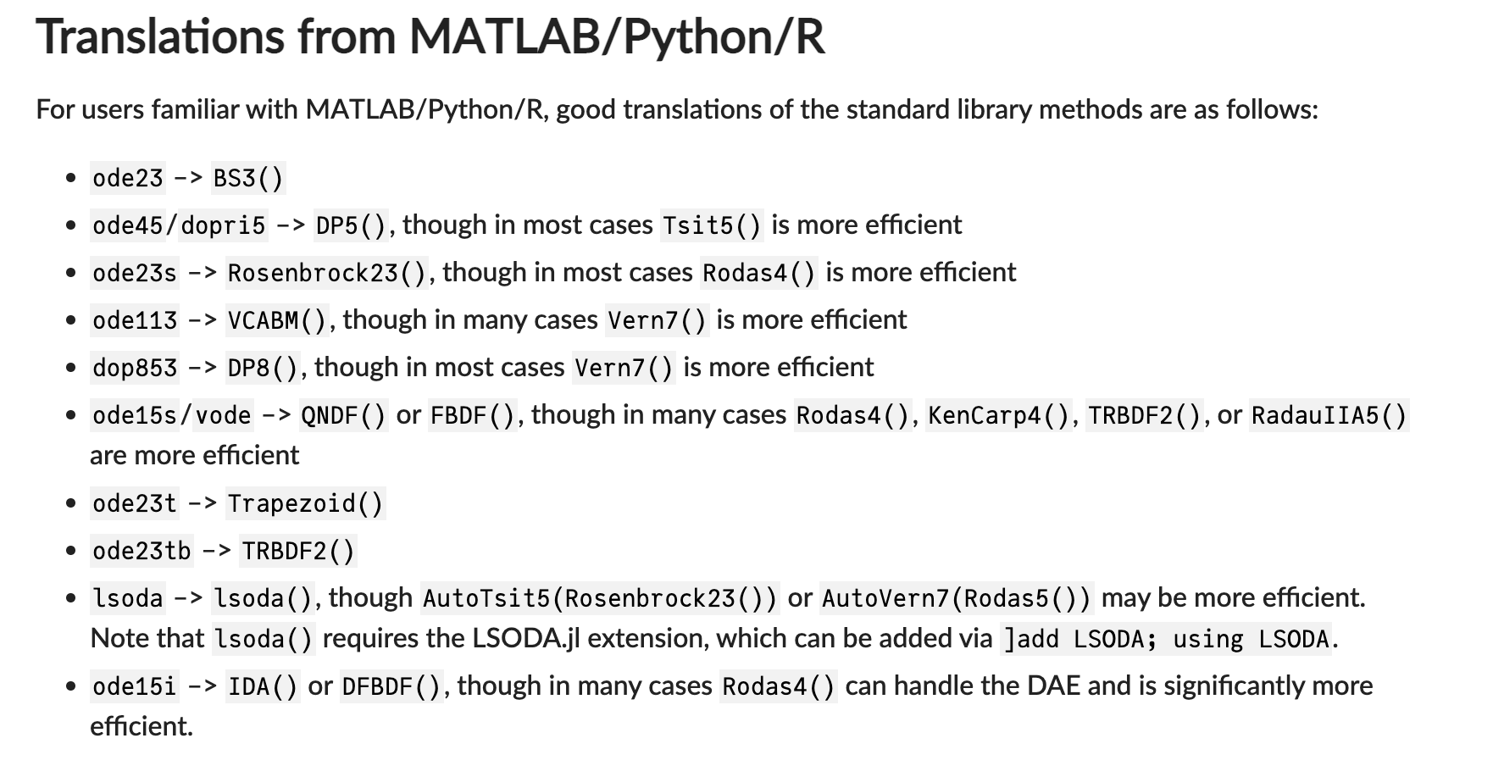
DifferentialEquations.jl - Solver suite
A huge number of solvers! See all @ https://diffeq.sciml.ai/stable/solvers/ode_solve/
Non stiff families:
Explicit Runge-Kutta Methods
Parallel Explicit Runge-Kutta Methods
Explicit Strong-Stability Preserving Runge-Kutta Methods for Hyperbolic PDEs (Conservation Laws)
Low-Storage Methods
Parallelized Explicit Extrapolation Methods
Explicit Multistep Methods
Adams-Bashforth Explicit Methods
…
Stiff families:
SDIRK Methods
Fully-Implicit Runge-Kutta Methods (FIRK)
Rosenbrock Methods
Stabilized Explicit Methods
DIRK Methods
…

Slide 29
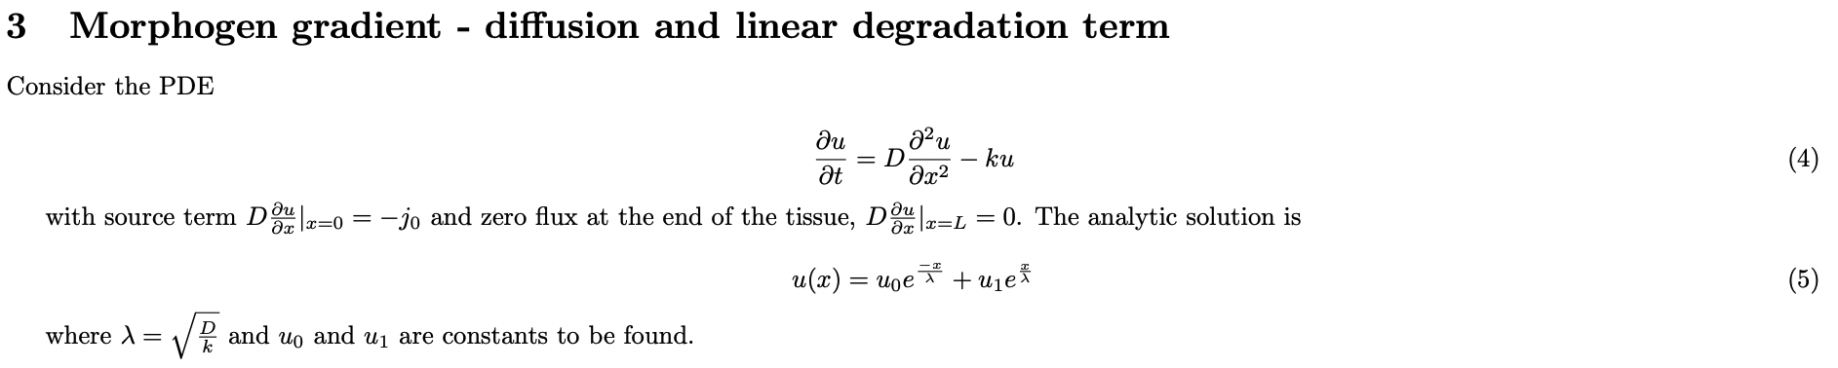
A simple PDE with DifferentialEquations.jl – Diffusing morphogen with linear degradation

Slide 30
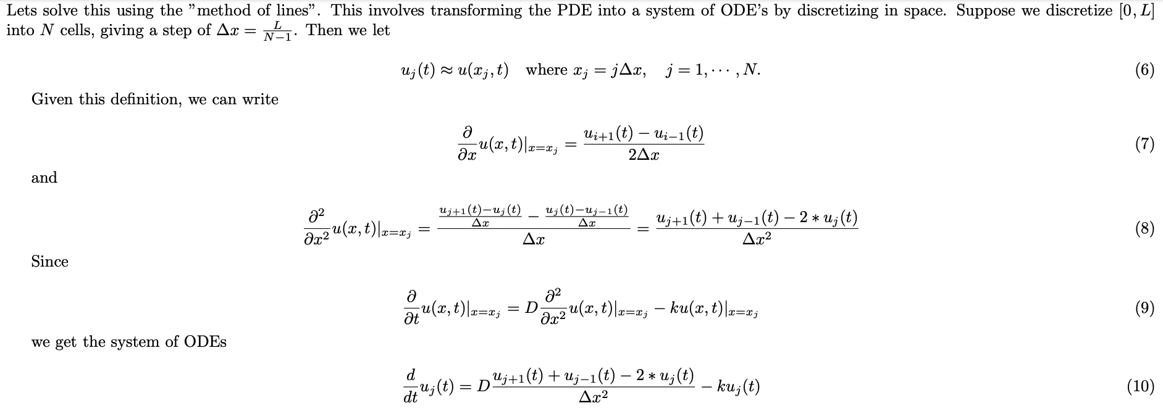
A simple PDE with DifferentialEquations.jl – Diffusing morphogen with linear degradation

Slide 31
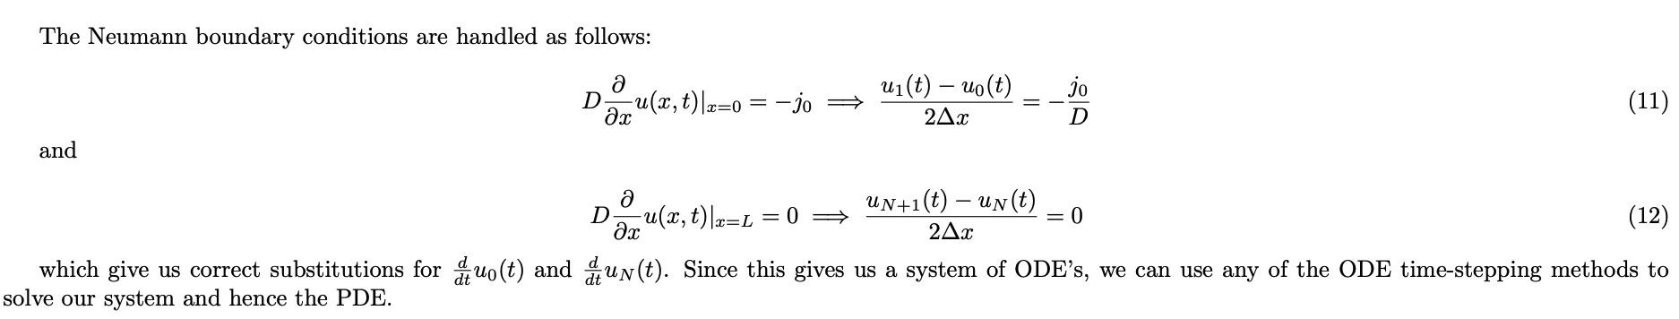
A simple PDE with DifferentialEquations.jl – Diffusing morphogen with linear degradation

Slide 32
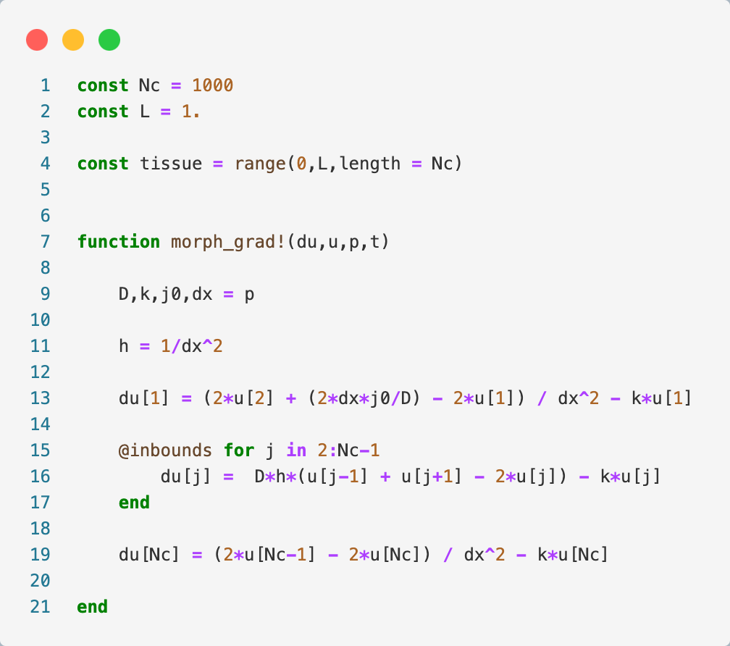
A simple PDE with DifferentialEquations.jl – Diffusing morphogen with linear degradation

Slide 33



A simple PDE with DifferentialEquations.jl – Diffusing morphogen with linear degradation
Notes:
Quick time scale initially
Implicit methods require an extra computation (solving the above equation), and they can be much harder to implement.
Implicit methods are used because many problems arising in practice are stiff, for which the use of an explicit method requires impractically small time steps to keep the error in the result bounded

Slide 34

A simple PDE with DifferentialEquations.jl – Stiffness
Notes:
Quick time scale initially

Slide 35



A simple PDE with DifferentialEquations.jl – Stiffness
Notes:
Quick time scale initially

Slide 36



Looking deeper into DifferentialEquations.jl - Growing Cell Population

Slide 37

Looking deeper into DifferentialEquations.jl - Growing Cell Population

Slide 38


Symbolic numerical programming – using MethodOfLines.jl for automated discretization of symbolically-defined PDEs

Slide 39





Symbolic numerical programming – using Catalyst.jl for automated modelling of reaction networks

Slide 40



Parameter estimation – using DiffEqParamEstim.jl to model parameters from noisy data

Slide 41


Parameter estimation – using DiffEqParamEstim.jl to model parameters from noisy data

Slide 42



Parameter estimation – using Turing.jl to perform Bayesian estimation of model parameters from noisy data

Slide 43


Parallel computing in Julia – Solving ensembles of random ODE problems
How to sample random diffusivities most effectively? MCMC Sampler…

Slide 44


Parameter estimation – using Turing.jl to perform Bayesian estimation of model parameters from noisy data

Slide 45

Parallel computing in Julia is easy

Slide 46

Using custom types in Julia is the key to happiness

Slide 47


Reproducibility– using DrWatson.jl to organize your code into reproducible projects

Slide 48

Reproducibility– using DrWatson.jl to organize your code into reproducible projects

Slide 49


Reproducibility– using DrWatson.jl to organize your code into reproducible projects
This tutorial: https://github.com/harrybooth/Hadjivasiliou_Julia_Tutorial

Slide 50
Useful resources
Parallelization
https://julialang.org/blog/2019/07/multithreading/
https://lup.lub.lu.se/search/files/61129522/julia_parallel.pdf
Julia
JuliaCon 2019 | The Unreasonable Effectiveness of Multiple Dispatch | Stefan Karpinski
Symbolic numerical computing
"Symbolic Numeric Programming in Julia" by Shashi Gowda (Strange Loop 2022)
Simulating Big Models in Julia with ModelingToolkit | Workshop | JuliaCon 2021
Parameter estimation
From Optimization to Probabilistic Programming
Optimizing Julia Code
What scientists must know about hardware to write fast code
Optimizing DiffEq Code, Chris Rackauckas
Useful examples
Solving Systems of Stochastic PDEs and using GPUs in Julia (2-dimensional Reaction-Diffusion Equations)
Bruseelator (Method of lines, automatic jacobians)
Which solvers
A Comparison of Some Codes for the Stiff Oscillatory Problem
Composability in Julia
Composability in Julia: Implementing Deep Equilibrium Models via Neural ODEs

